Slide 1

Transforming Natural Language Queries into SQL Queries
Mid-Term Project
-Parjita Munshi

Slide 2
Introduction
Focus: transforming natural language queries into SQL queries
Data: Access format and was converted into a EXCEL and then CSV format and insert into SQLite.
Tables:
Customer,
Categories,
Menu Items,
Order Items,
Orders December,
Order Table,
Product Table,
Sales Unit
Operations: join operations (inner, outer, semi, equi) and aggregate operations (sum, average).

Slide 3
Methodology
Data Collection: Collect data from multiple CSV files using Pandas.
Database Creation: Create an in-memory SQLite database with SQLAlchemy.
OpenAI API Integration: Integrate the OpenAI API for SQL query generation. Set the API key for authentication.
Prompt Generation: Create prompts for defining table structures and SQL queries.
User Input: Collect user questions or desired information.
Prompt Combination: Combine prompts for table structure and query generation into a single prompt.
OpenAI Query Generation: Send requests to OpenAI to generate SQL queries using appropriate models.
Response Handling: Process OpenAI responses to extract generated SQL queries.
SQL Query Execution: Execute the generated SQL query in the in-memory database using SQLAlchemy.
Result Retrieval: Retrieve and store the results of the executed SQL query.

Slide 4
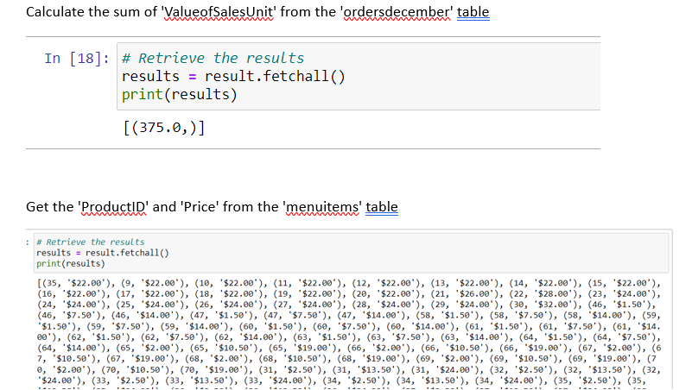
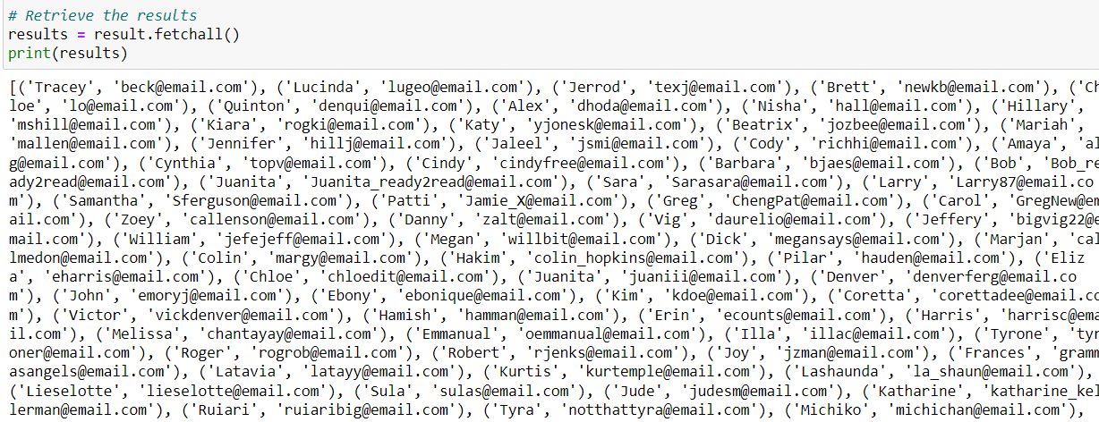
Simple Query Result
Find name and email of customers

Slide 5
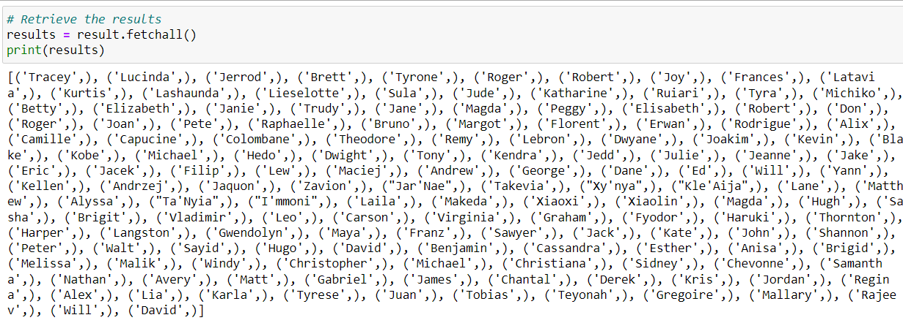
Complex Query Result
Retrieve 'FirstName' from the 'customers' table in the 'productinfo' database, where 'ID' is not in the result of a subquery that selects distinct 'ID' from the 'orderstable' table in the

Slide 6
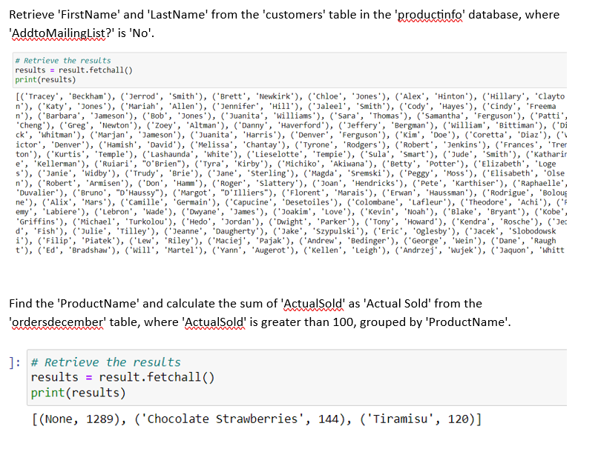
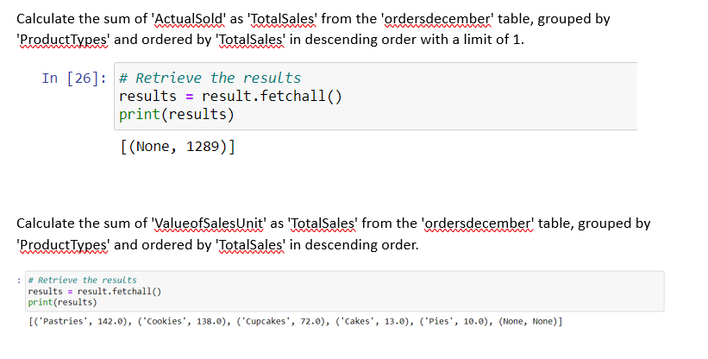
Complex Query Result

Slide 7
Limitations
According to My model, Need to provide large amount of training data for accurate result.
Need to write accurate natural language query
This model not working on random queries

Slide 8
Conclusion
this project successfully demonstrated the ability of ChatGPT to effectively transform natural language queries into accurate SQL queries, offering a promising solution for automating the database querying process. Through semantic equivalence testing, we confirmed the consistency of results across different ways of expressing queries in natural language.

